Slide 1
DD2424
All about Efficient Convnets
Yann Debain Suhas Sheshadri Harsha HN
Notes:
@1/2 Min Based on shufflnet: CNN
Demo its comp merit. Implement shufflnet for Imagenet classification task
Eval of model perf: acc & complex for var config setups. Extension: comp acc & complex opp to MobileNet & v2.

Slide 2
Background & related works
How to solve complex visual recognition tasks?
- -> Let’s build deep & large CNN!
Computational burden 😰 ⇒ Not suitable for Embedded apps.
AlexNet (GConv) - Inception - ResNet (skip) - SqueezeNet (PConv) - MobileNet (DWConv)
Group convolution
By AlexNet
Point-wise Group convolution
Depth-wise separable convolution
By Xception
Used by MobileNet, EffNet etc
Channel shuffle: IGCNets - interleaves channels
NASNet (2017) - EffNet (2018) - C3AE(2019)
Notes:
@2.5 mins! Deeper & larger CNN toward complex task but incur comp burden for embedded space. In this pursuit,
LeNet -> AlexNet - Group conv(filter relationships are sparse), Inception(x1 x3) & Resnet(skip conn) outforms. 1x1 squeezenet pointwise (x50 model size -same acc), 3x3 mobilenet DW Sep conv[by Xception] (outperforms by same model size). EffNet (github) uses spatial separable convolution, which is simply a depthwise convolution splitted along the x and y axis. NASNet(best of conv 2017) - EffNet(2018) - C3AE 1/9(2019)
Channel Shuffle and Split by IGCNets random shuffle

Slide 3









Dataset :
Tiny ImageNet
200 classes, 8 bits, 64x64 pixels RGB
Training | Validation
100,000 | 10,000
Extract - Transform - Load
Images
tfRecords
Feed the model
Read images
Original
←------------------- Augmented images --------------------->
Data-augmentation
Notes:
@3.5 min… Data-augmentation (crop, flip, brightness, contrast, hue, and saturation) To serialize our data and store it in a set of files that can each be read linearly. TfRecords file format. Mini-batch, shuffled.

Slide 4
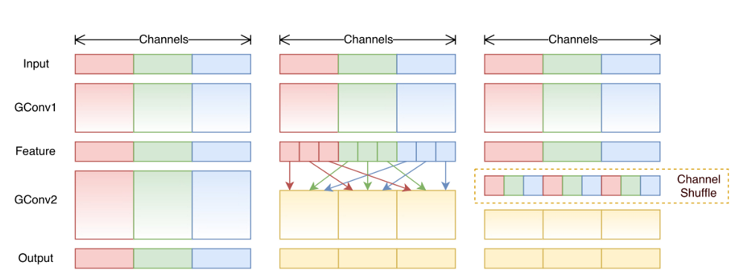
The Model : ShuffleNet v1
Notes:
@3.30 sec
Although group convolution significantly reduces the computational burden, it facilitates smaller feature map, channel shuffle enables cross-group information flow and allows a wider feature map between convnets layers.

Slide 5
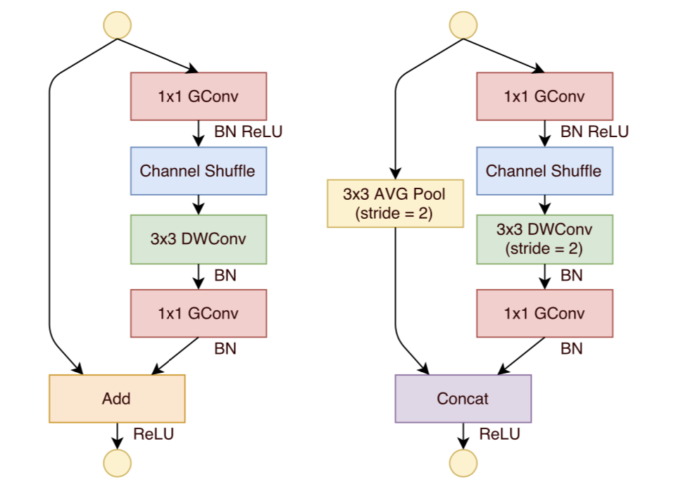
The Model : ShuffleNet v1 - Shuffle Units
Notes:
@4 min...further operations were to be performed to achieve group convolution, channel shuffle and channel split to form shuffle net units.

Slide 6
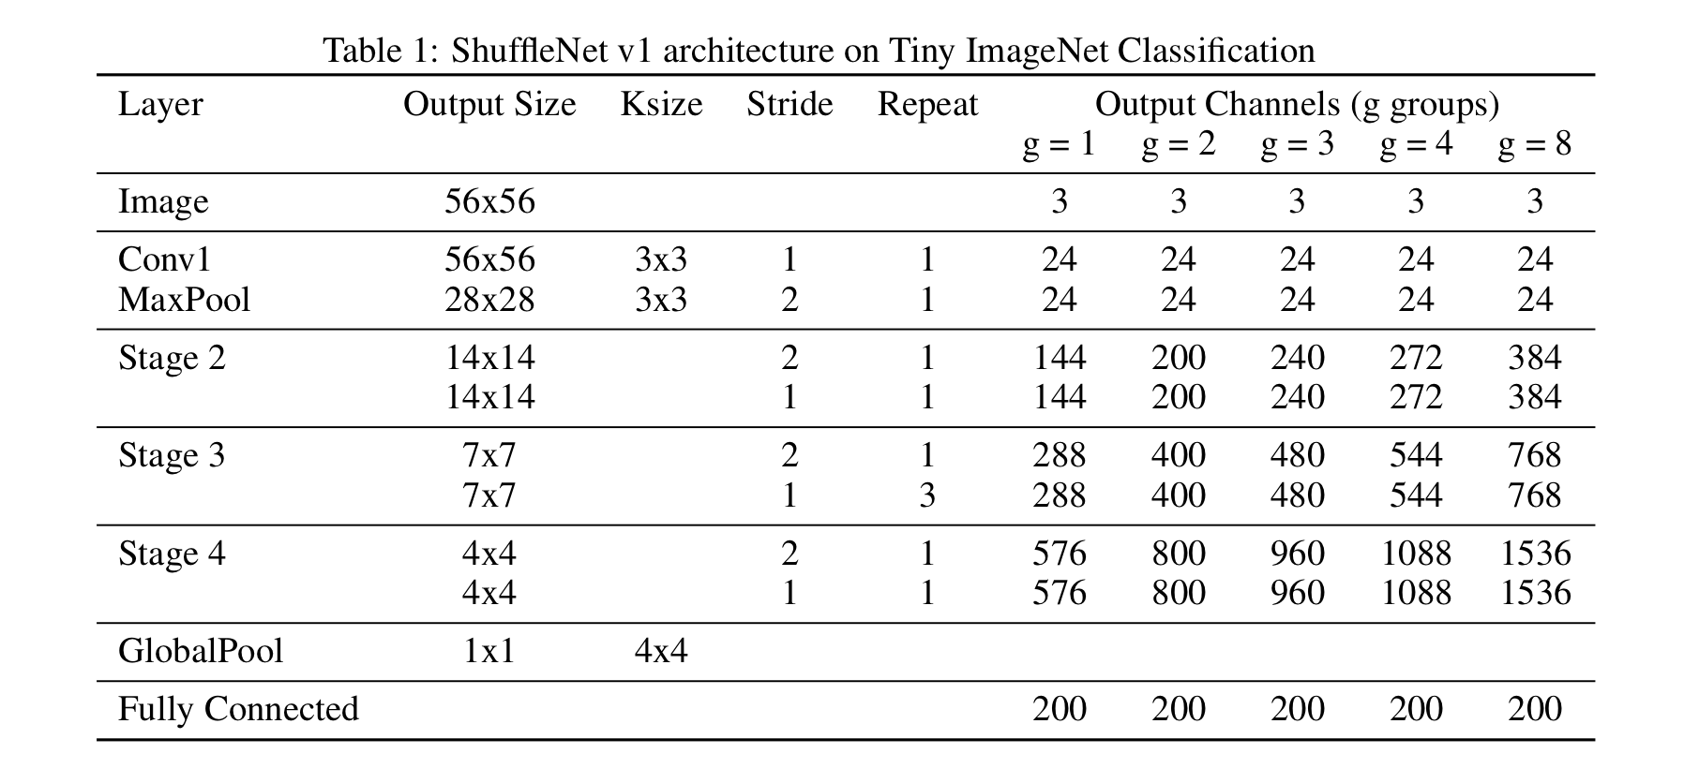
The Model : ShuffleNet v1 - Architecture
Notes:
@4.10

Slide 7
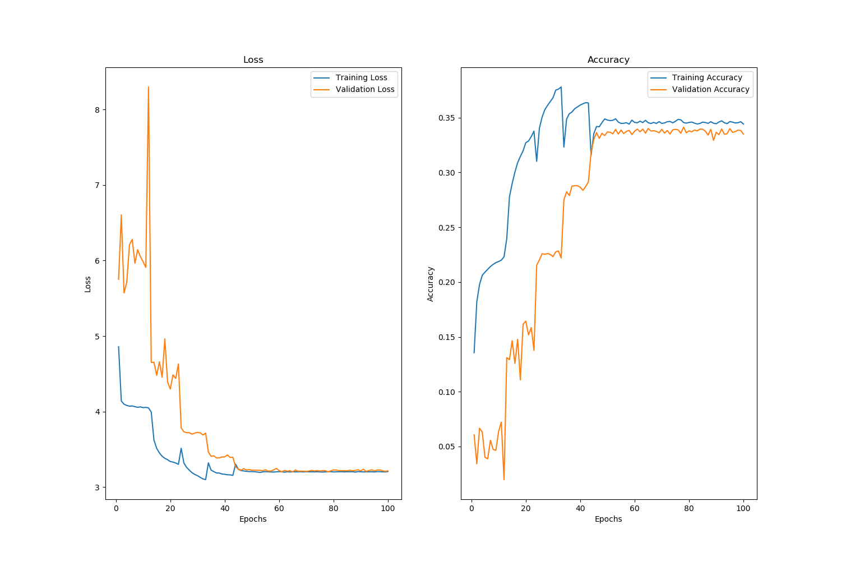
The Model : ShuffleNet v1 - Training Process
Eta = 0.1
Drop = 0.1
Reg = 5e-3
Epochs = 100
Batchsize = 200
Performance of ShuffleNet v1 (groups = 1, complexity = 0.25)
Notes:
@4.30
Inits - Nesterov optimizer - drop learning rate of factor 0.1 at each time the validation accuracy plateaus - L2 regularization
How did we end up with these specific hyperparameter values.

Slide 8
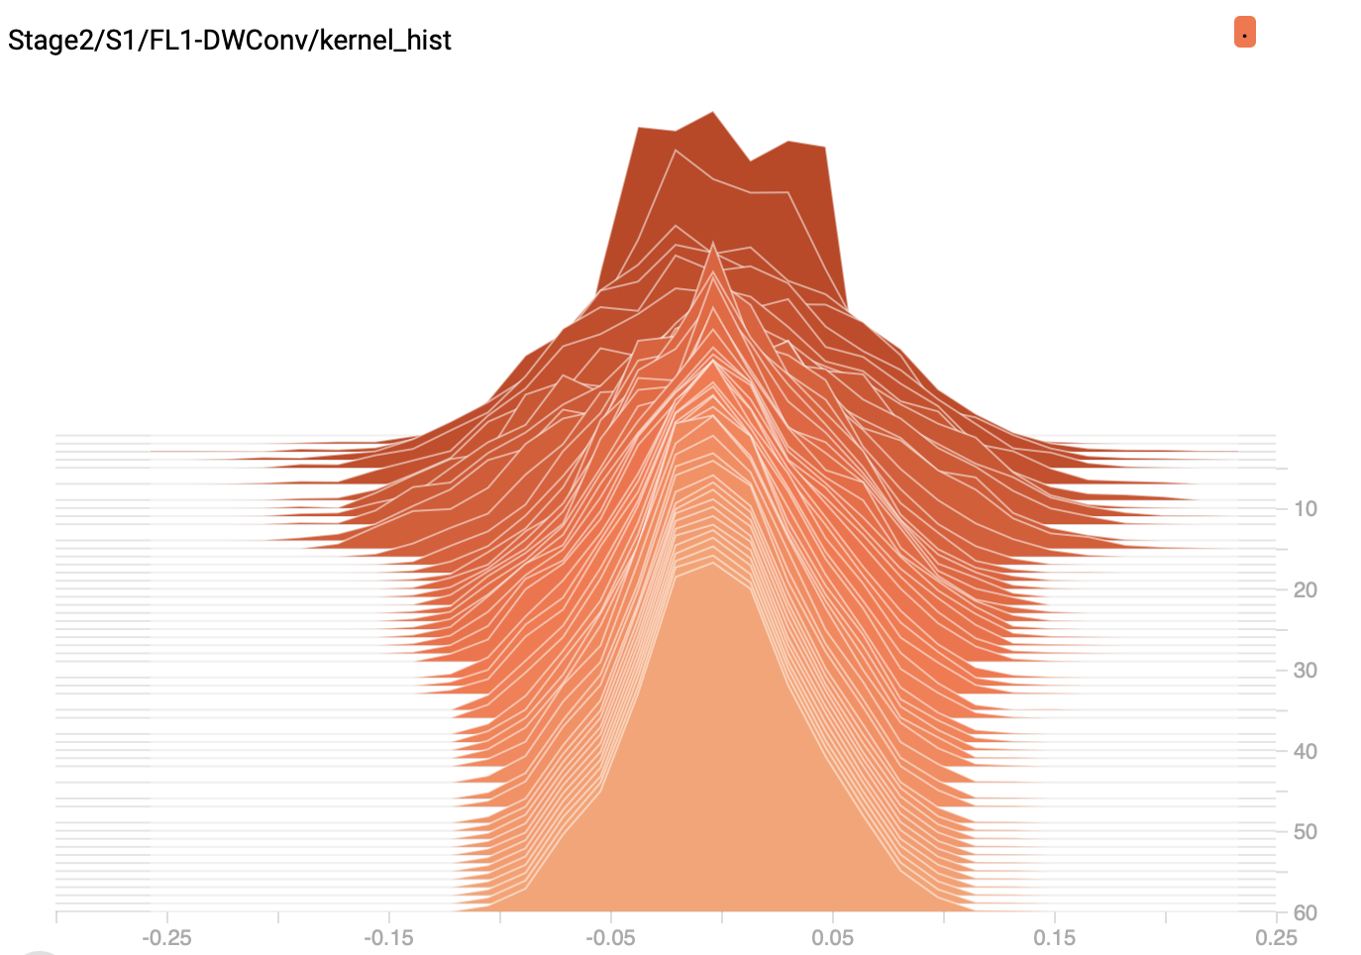
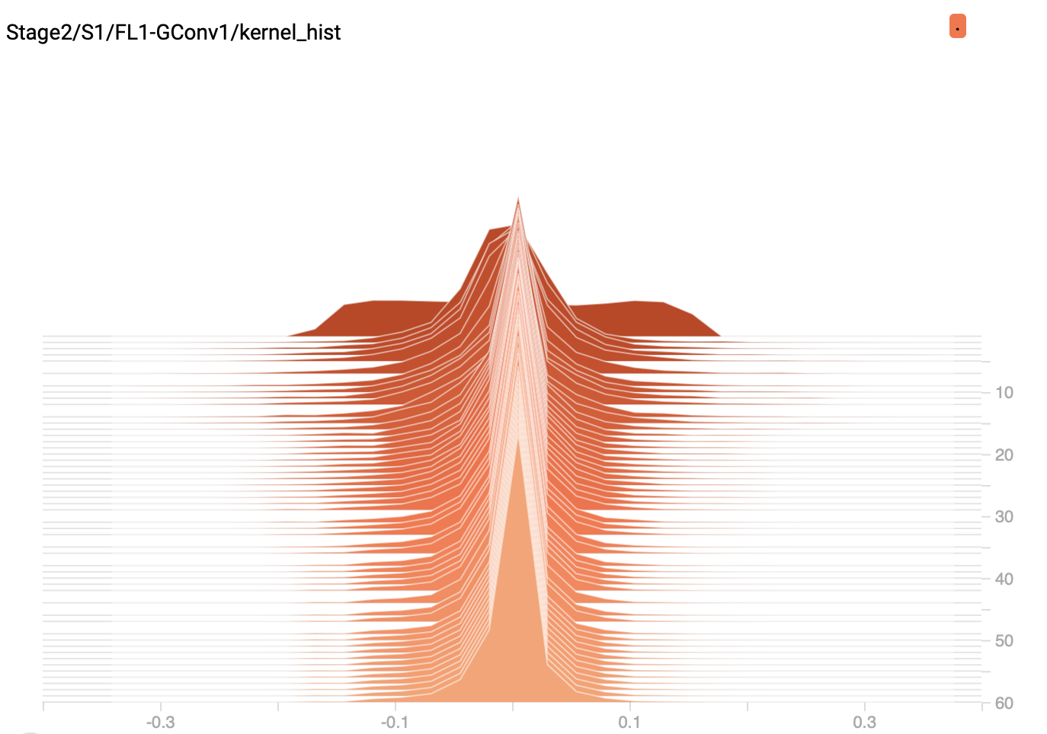
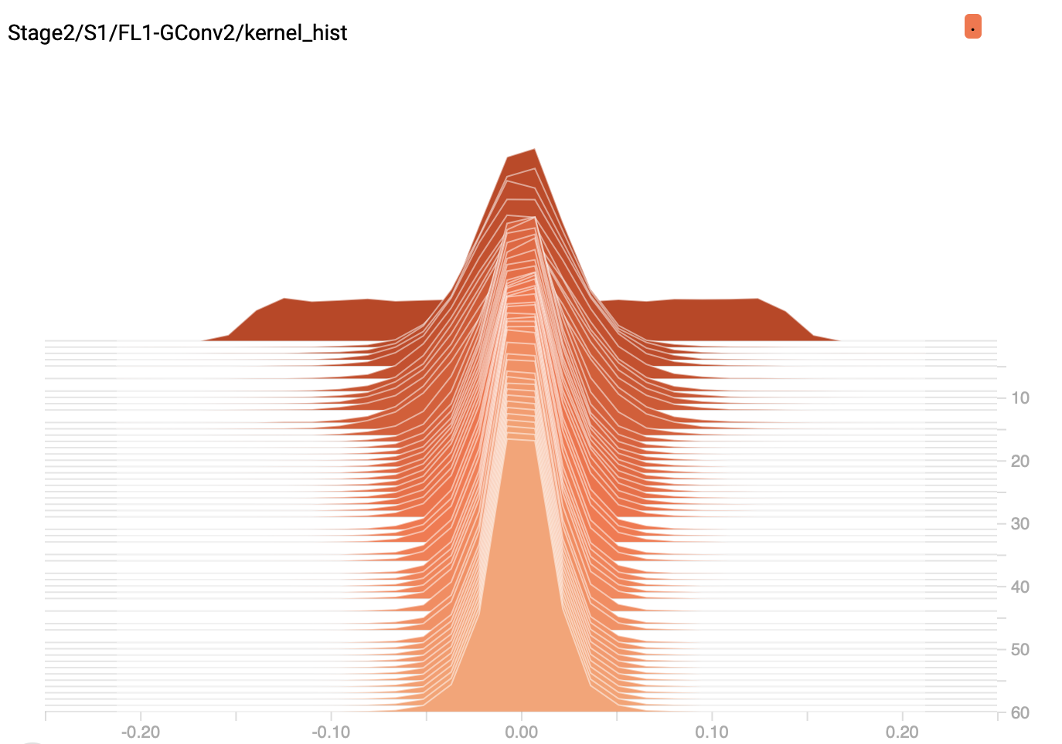
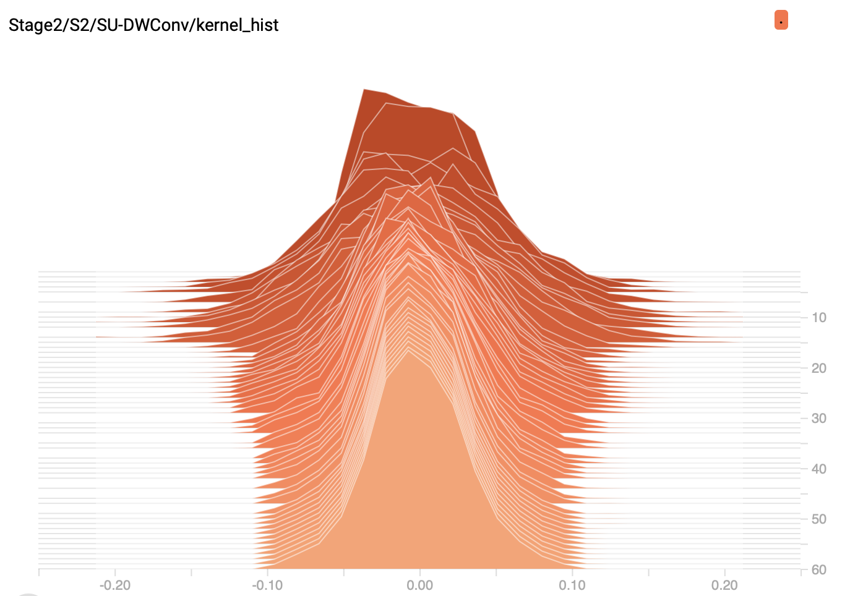
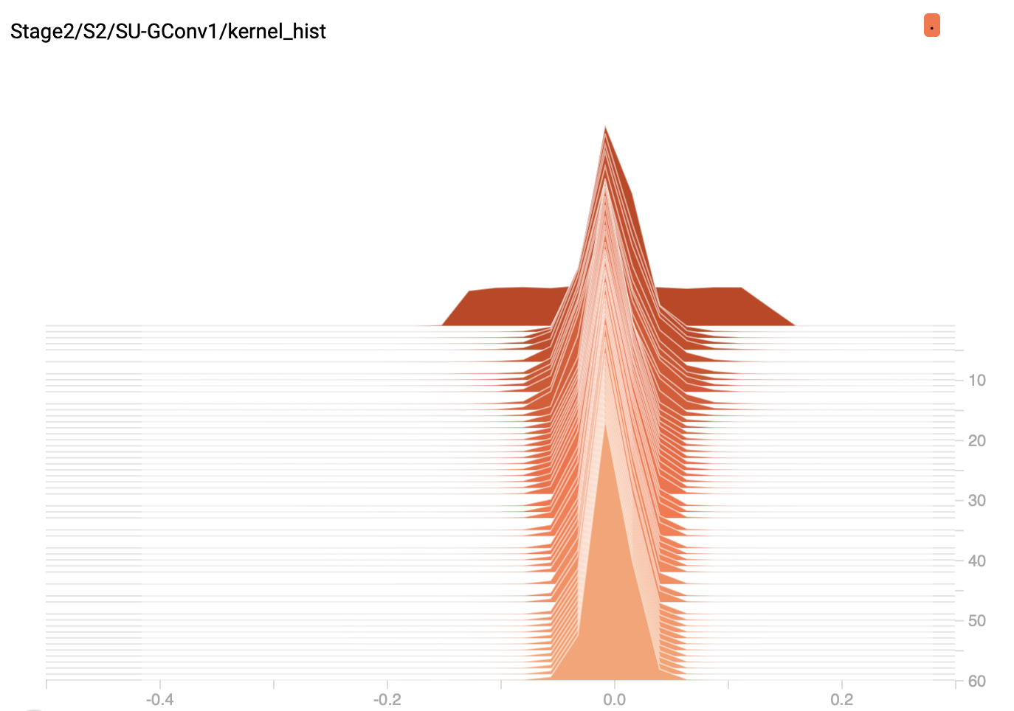
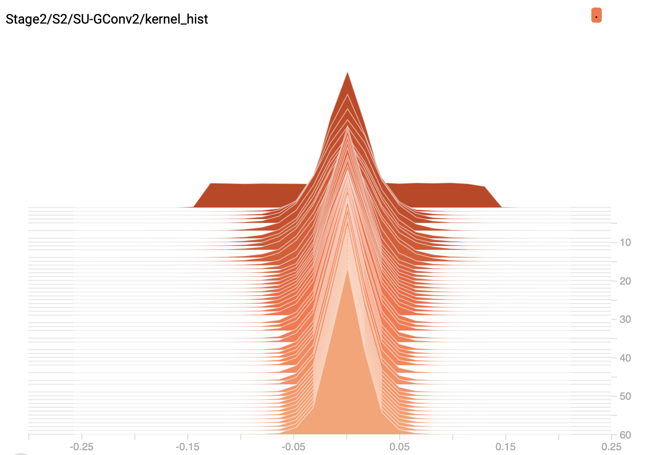
The Model : ShuffleNet v1 - Training Process
Notes:
@4.50

Slide 9
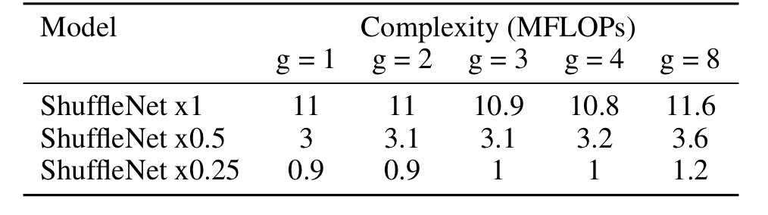
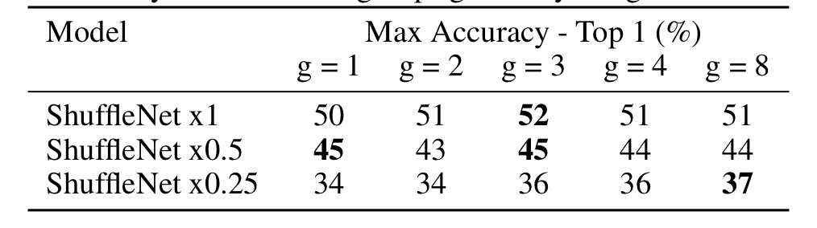
Experiments :
Performance of ShuffleNet v1
Complexity vs. number of groups g on Tiny ImageNet Classification
Accuracy vs. number of groups g on Tiny ImageNet Classification

Slide 10
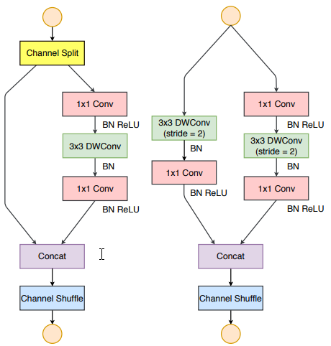
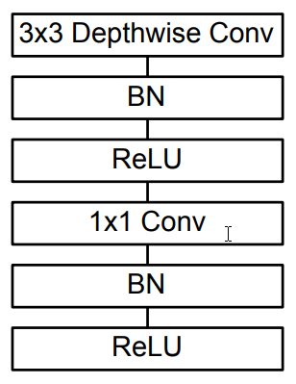
ShuffleNet v2 MobileNet
Experiments : Model Extension
Notes:
Implementation for comparison purpose

Slide 11
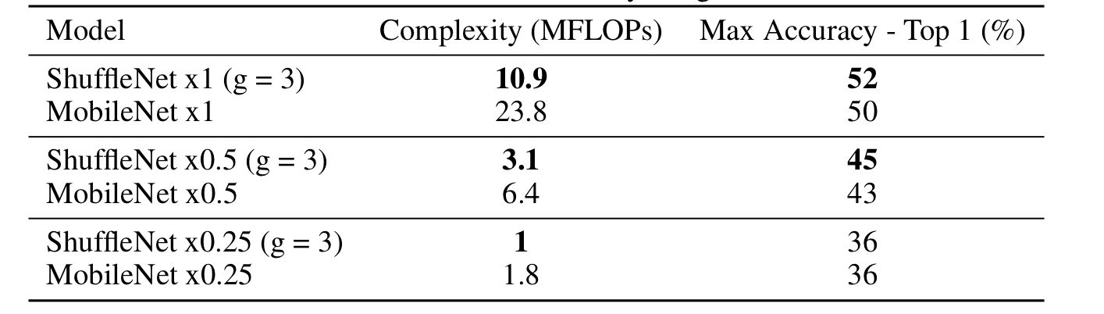
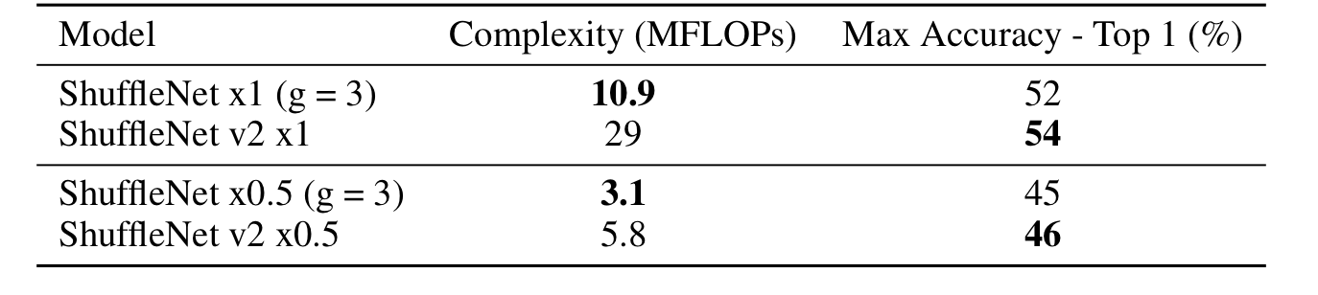
Experiments :
Comparison with MobileNet and ShuffleNet v2
ShuffleNet v1 vs. MobileNet on Tiny ImageNet Classification
ShuffleNet v1 vs. ShuffleNet v2 on Tiny ImageNet Classification

Slide 12
Conclusion
ShuffleNet is an efficient Convolutional Neural Network for Mobile devices by reducing the computational burden for a comparable accuracy with other popular Deep Convolutional Neural Network (MobileNet, ResNet, GoogleNet, ...)
Channel shuffle enables cross information flow enabling wider feature map across convnets.
Learn popular training process : SGD + Momentum + Nesterov, Drop learning rate
Learn Software Package and tool : Tensorflow, TensorBoard, GCP

Slide 13
Individual learning outcomes
Yann Debain
ConvNet Designs
Use of TensorFlow, TensorBoard and GCP
Solution to a given problem
Harsha HN
Efficient convnet designs
Write & train using TF
Project execution & conference style reports
Suhas Sheshadri
Reproduce a scientific paper with improvements
Implement ConvNets
Practice tools like TensorFlow and GCP

Slide 14
Content and Creativity
The presentation contained relevant material clearly related to the main arguments. External research was used to justify arguments or solutions. The presentation of the material was presented in a creative way that held audience attention.
Coherence and Organization
The thesis, argument and solution were
clearly stated and examples were appropriate. The transitions and flow were easy to follow. Slides were mainly error-free and logically presented.
Speaking Skills and Participation
Group members were poised and had clear articulation. Every group member spoke and participated at a very high and balanced level. The presentation t into the allotted time limit.
Grading rubric for the presentation [20% marks]
Notes:
Aimed to explaining related work, implementation issues to perhaps some high-level explanation of background technical stuff. What you did and what you learnt in this process.

